Slide 1

SLU-0106-DVT · TEAM 21
DePaul University
Applicant Data Analytics
Final Presentation & Internship Reflection
Prepared by TEAM 21 | Week 4 Deliverable | 2026
Four weeks of exploration, cleaning, and dashboarding
the international admissions pipeline.

Slide 2




INTERNSHIP JOURNEY
From Raw Export to Actionable Dashboard
Over three weeks, this project took our group through DePaul University's international admissions full analytics lifecycle — from understanding a messy, denormalized dataset to delivering a four-page interactive Power BI dashboard for recruitment leadership.
WEEK 1
WEEK 2
WEEK 3
WEEK 4
Data Exploration
Data Cleaning
Dashboard Build
Insights & Reflection
Profiled 7,543 rows across 80 columns; identified structure, gaps, and quality issues.
Reduced to 14 clean columns and 4,981 valid rows; cut missing values by 99.4%.
Designed a 4-page Power BI dashboard: Executive, Program, Geographic, Recruitment.
Synthesized findings into recommendations and reflected on the learning journey.
DePaul University Applicant Analytics | SLU-0106-DVT Team-21
2

Slide 3

WEEK 1
Data Exploration & EDA
What we found in the raw export
TOP COUNTRIES BY APPLICANT VOLUME
Denormalized join of 3 source tables — evidenced by duplicate -2/-3 suffixed columns
27 of 80 columns (33.75%) were entirely empty (Citizenship, SEVIS_ID, Date_of_Birth…)
Reference_ID was not a unique key — 2,543 IDs repeated across multiple outreach events
Inconsistent formats throughout: phone numbers, country casing, raw timestamps
"Intake" field bundled program, degree, and term into a single unparsed string
Key takeaway: Rows ≠ applicants. The dataset captures outreach events, not unique people — all applicant-level KPIs require deduplication by Reference_ID before any analysis.
DePaul University Applicant Analytics | SLU-0106-DVT Team-21
3

Slide 4
WEEK 2
Data Cleaning & Quality Improvement
A 15-step cleaning process turned noise into a working dataset
80 → 14
7,543 → 4,981
371,657 → 2,222
0
Columns retained
(82.5% reduction)
Valid rows kept
after dedup & cleanup
Missing values
(99.4% reduction)
Duplicate records
in final dataset
SPECIFIC CORRECTIONS MADE
DATASET COMPARISON: BEFORE vs AFTER
Recieved_At (raw timestamp) | Admit_Date (ISO format, e.g. 2024-03-25)
Degree_Type — 100% empty | Degree_Level — 15 clean values (MS, MBA, MA…)
"United states" / mixed casing | Standardized: "United States"
Phone: 9.20E+11 (scientific notation) | +91 XXXXX XXXXX (normalized)
DePaul University Applicant Analytics | SLU-0106-DVT Team-21
4

Slide 5



WEEK 3
Interactive Power BI Dashboard
A four-page dashboard built on the cleaned dataset (7,543 records, 5,000 unique applicants, May 2023–June 2025), connected through shared slicers and cross-filtering.
PAGE 1
PAGE 2
PAGE 3
PAGE 4
Executive Summary
Program Analysis
Geographic Analysis
Recruitment Analysis
KPI cards, trend line, source donut, college bar chart, date slicer
Program ranking, term-over-term columns, college × term matrix
Filled world map, country table, top-10 bar chart, cross-filter
Funnel chart, outcome bars, caller table, campaign slicer
7 DAX measures (Total Applicants, Admission Rate, Slate Filled, Contacted, Follow Up, Missing Transcript, and more) recalculate live across all four pages from one underlying table.
DePaul University Applicant Analytics | SLU-0106-DVT Team-21
5

Slide 6
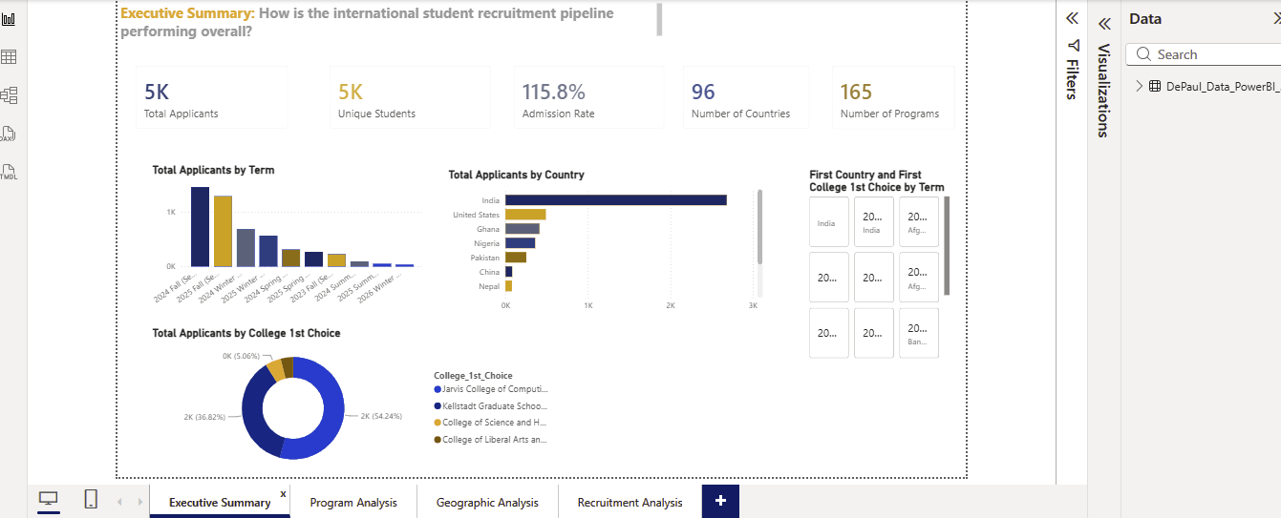
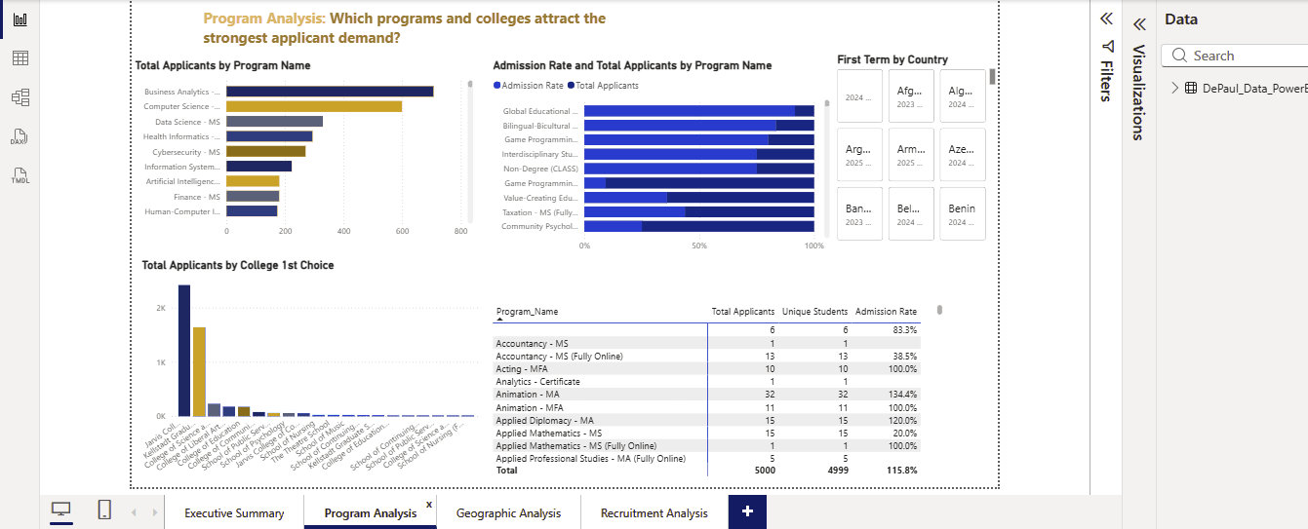
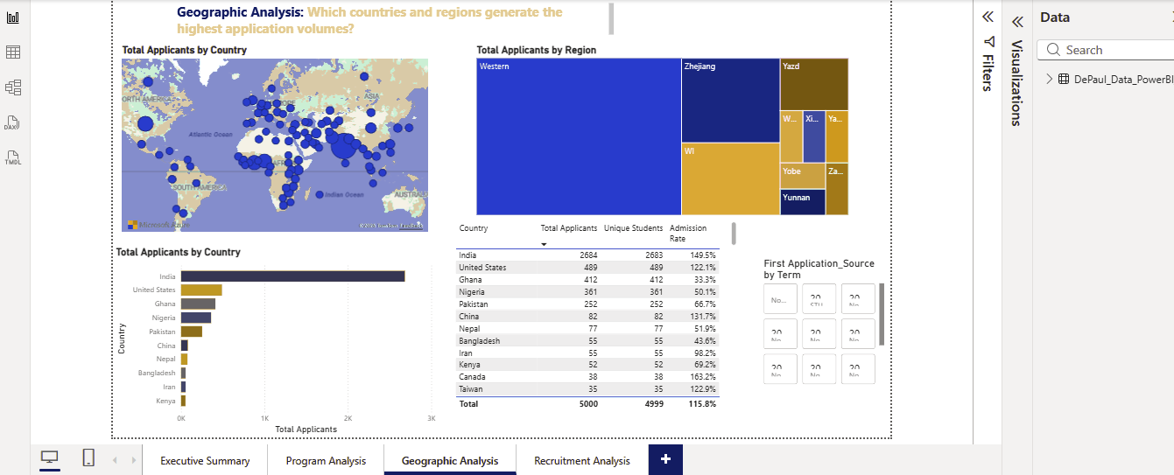
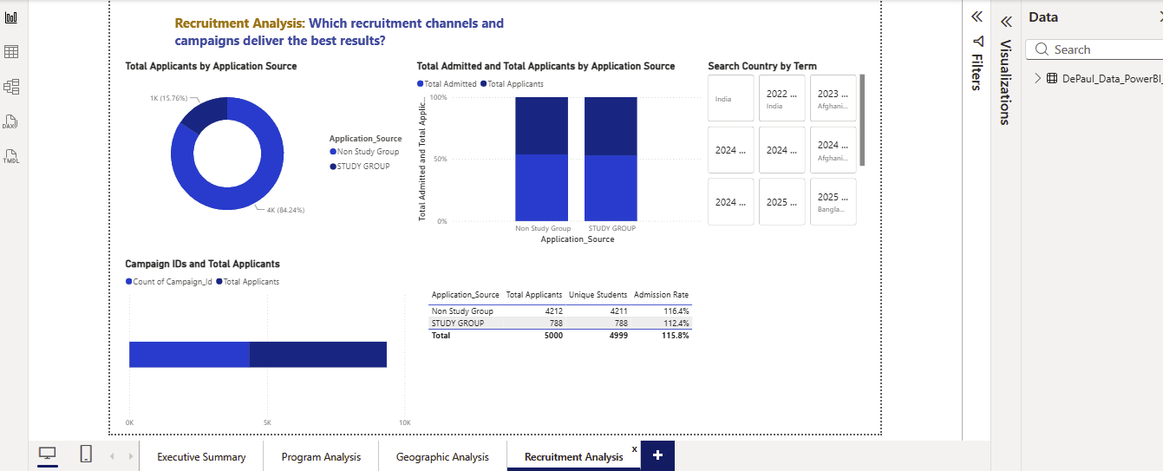
WEEK 3
Dashboard in Action
Executive Summary — KPI overview & trend
Program Analysis — demand ranking & term trends
Geographic Analysis — applicant concentration by country
Recruitment Analysis — conversion funnel & outreach
DePaul University Applicant Analytics | SLU-0106-DVT Team-21
6

Slide 7
INSIGHT REPORT
Program & Geographic Findings
1
Business Analytics MS leads demand
1,080 applicants vs. 1,055 for Computer Science MS — steady across Fall and Winter, not just seasonal.
2
AI program is accelerating
Artificial Intelligence applications roughly doubled term-over-term from 2023 to 2024 — a clear capacity-planning signal.
3
Jarvis College dominates the pipeline
Computing & Digital Media draws 50.8% of first-choice applications vs. 33.5% for Kellstadt Business.
4
India is 61% of the pipeline
4,617 of 7,543 applicants originate from India — a deep talent source, but also a concentration risk.
5
Africa is an emerging market
Ghana (440) and Nigeria (430) combined exceed the entire U.S. domestic applicant pool (764).
DePaul University Applicant Analytics | SLU-0106-DVT Team-21
7

Slide 8

INSIGHT REPORT
Recruitment Funnel Findings
1,375
Applicants in "Follow up" status — engaged but not yet converted. The single largest yield opportunity.
Three counselors carry 99% of outreach
Jagdeep
1,177
Applicants stalled on "Missing Transcript" — the largest single drop-off cause in the funnel.
2085
Swarna
1214
99.7%
Slate form completion rate — counselor follow-through is effective once an applicant engages.
Ayesha
855
This concentration is a key-person risk: if any one counselor is unavailable, outreach capacity drops sharply.
DePaul University Applicant Analytics | SLU-0106-DVT Team-21
8

Slide 9
RECOMMENDATIONS
Turning Insights Into Action
Recruitment Targeting
Counselor Engagement
Admission Outcomes
Diversify beyond India with campaigns in Pakistan, Kenya, and other growing markets
Invest in Ghana and Nigeria — already outproducing the entire U.S. domestic pipeline
Strengthen Winter/Spring incentives to smooth the 65%+ Fall-term concentration
Cross-train additional staff to reduce reliance on 3 counselors handling nearly all calls
Build a structured 30/60/90-day sequence to convert the 1,375 "Follow up" applicants
Launch a proactive transcript-reminder workflow at the point of application submission
Expand AI program capacity and marketing ahead of its term-over-term doubling demand
Track Business Analytics selectivity as volume continues to lead all programs
Evaluate Study Group ROI with a cost-per-enrolled-student analysis
DePaul University Applicant Analytics | SLU-0106-DVT Team-21
9

Slide 10


CRITICAL REFLECTION
Limitations & Future Work
A good analysis is honest about what it can't yet answer. These are the boundaries of this project, and where it could go next.
Known Limitations
Recommended Next Steps
2025 data is in-progress — only 607 admits recorded so far, so year-over-year trends understate the current cohort
Admission outcomes (Is_Admitted) were 100% empty in this extract, limiting true conversion-rate analysis
Two-category Application Source field restricts deeper channel-level ROI comparison
Dashboard reflects a single point-in-time export, not a live-refreshing connection to DePaul's CRM
Connect the dashboard to a live data source for automatic refresh instead of a static export
Once Is_Admitted populates, build a full funnel conversion-rate model from application to enrollment
Add a cost-per-enrolled-student metric once Study Group spend data becomes available
Expand geographic analysis to a rolling 12-month view as 2025/2026 data matures
DePaul University Applicant Analytics | SLU-0106-DVT Team-21
10

Slide 11



METHODOLOGY
Tools & Process Summary
Python (pandas)
THE PIPELINE
Data loading, missing-value analysis, duplicate detection, date standardization
1
Raw CRM export (7,543 × 80)
Power BI Desktop
2
Profiling & data dictionary
Power Query cleaning, DAX measures, four-page interactive dashboard build
3
Power Query cleaning (Python validated)
Microsoft PPT / Docs/Sheets
4
Analysis-ready table (4,981 × 14)
Documentation, insight reports, and presentation formatting
Power BI model + DAX measures
5
6
4-page interactive dashboard
DePaul University Applicant Analytics | SLU-0106-DVT Team-21
11

Slide 12
Thank You
This is the link to our group presentation
https://drive.google.com/file/d/1HTHPi0kOmhothM8v2Y9X2Ts5rkGFRwa-/view?usp=sharing
Team Presenter
SLU-0106-DVT · Team 21 · DePaul University Applicant Analytics

